Slide 1
Hopedale Town Park Revitalization
Hopedale Parks Commission

Slide 2
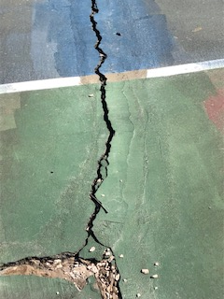
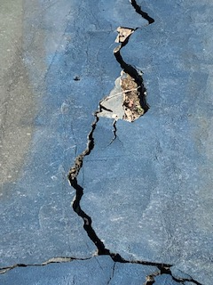
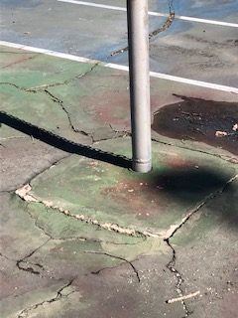
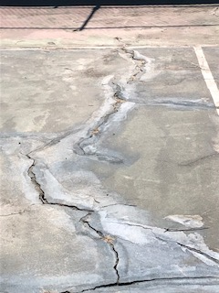
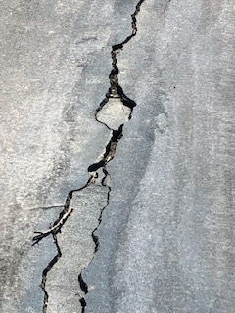
Current Conditions (Tennis & Basketball Courts)

Slide 3
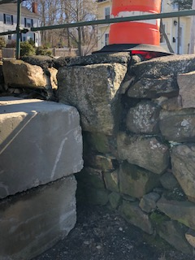
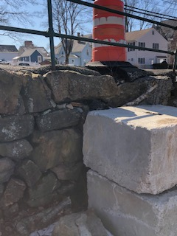
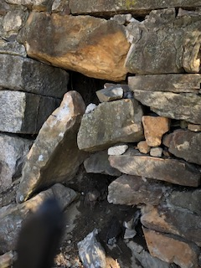
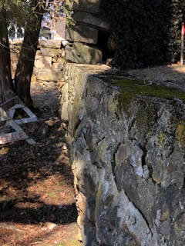
Current Conditions (Retaining Walls)

Slide 4
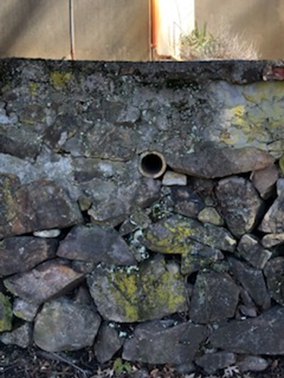
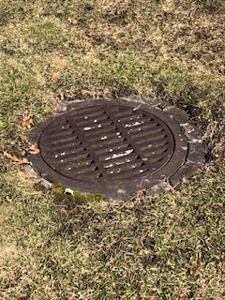
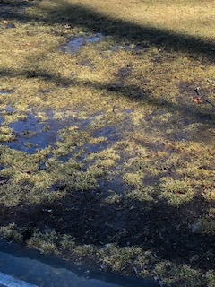
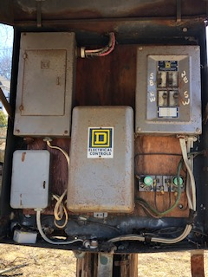
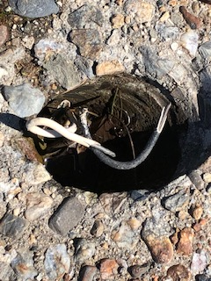
Current Conditions (Drainage & Electrical)

Slide 5
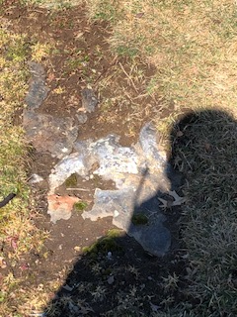
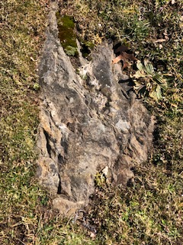
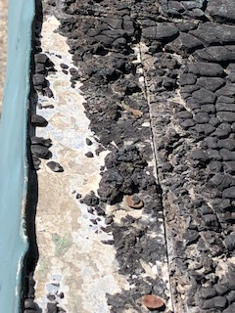
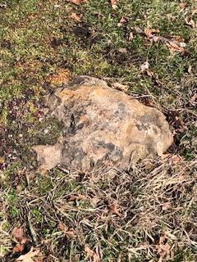
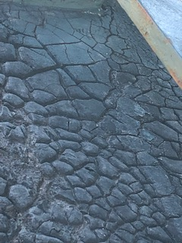
Current Conditions (Field & Band Stand)

Slide 6
What is our goal
Execute a plan that will improve Town Park by making it safer, updating/replacing the existing infrastructure that will meet the recreational needs of our residents and town athletic programs.
High Level Proposed Plan/Concept Scope of Work
New Tennis and Basketball Courts
New Synthetic Turf Baseball Field and Athletic Field for multi-purpose use (i.e., Field Hockey, Soccer)
New Electrical for all fields/courts
New walkways, trees, rock retaining walls and common area
All new drainage
Out of Scope
Playground, bandstand and bathrooms
Irrigation but w/ turf fields would not be required

Slide 7
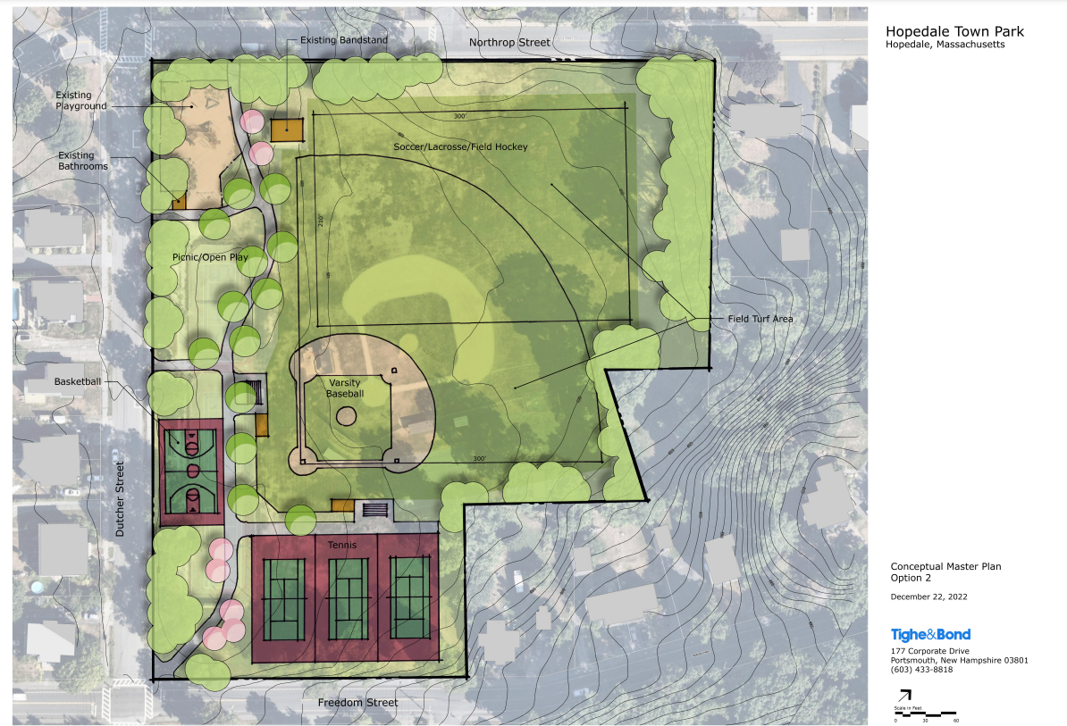
Visual
Tennis Courts would be relocated to the Freedom Street side of the Park to maximize overall space
Basketball Court relocated to Dutcher street side for safety/visibility
Baseball field would me moved to make room for synthetic fields in the outfield for multi-use purposes
Trees to be added and removed as required with new walkways for overall accessibility

Slide 8
Project financials
Finance- Total Project $3,756,968
Earthwork – $393,160
Drainage – $150,625
Lightning – $400,000
Pavement – $107,140
3 Tennis Courts –$263,480
Basketball Court – $81,070
Baseball Field – $109,400
Athletic Field – $1,305,000
Landscaping – $80,100
Contingency 30% – $866,993
Additional Cost
Design / Survey / GeoTech - $150000
**Detailed cost in appendix
How do we Finance this project:
Town Bond
CPA Funds
Potential Grants
Donations/Matching gifts (Community, Hopedale Foundations, Economic development projects…etc.)

Slide 9
High Level Timeline
Q4 2022 - Meet with Tighe&Bond
January 2023 - Review concepts with Tighe&Bond representative
January 19 2023 - Parks Commission town meeting to vote on a concept
February 2023 - Reconnect with Tighe&Bond to provide finalize numbers
March 2023 - Present to Board of Selectman and Finance Committee
March / April 2023 - Social and meet with Finance and other boards
April 2023 - Lock down outside funding
May 2023 - Funds Approved
June 2023 - Start work on Design / Survey / Geotech
Nov / Dec 2023 - Finalize Design / Survey / Geotech
Jan 2024 - Put to Bid
March 2024 - Contractors Begin
August / October 2024 - Complete Project

Slide 10
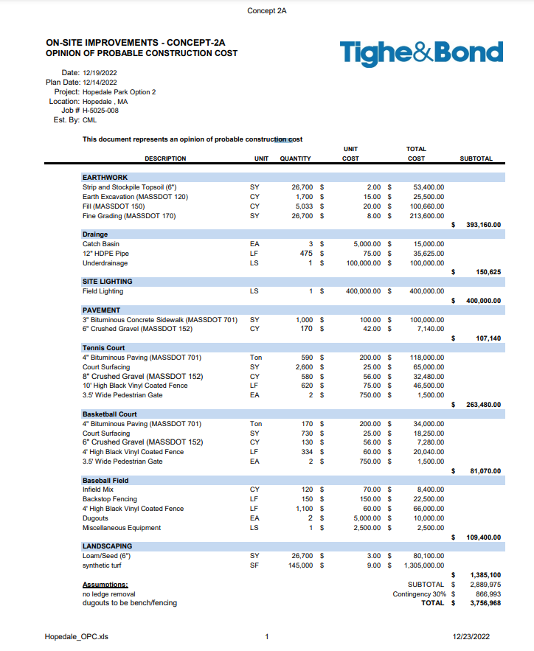
Appendix

