Slide 1
Town of Hopedale
Board of Selectmen Meeting
October 20, 2020
Update on 364 West Street

Slide 2
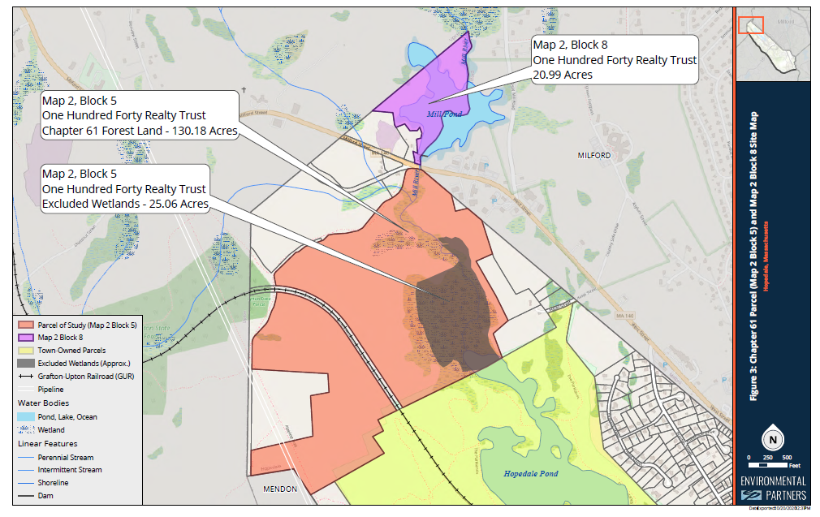
The Properties:

Slide 3
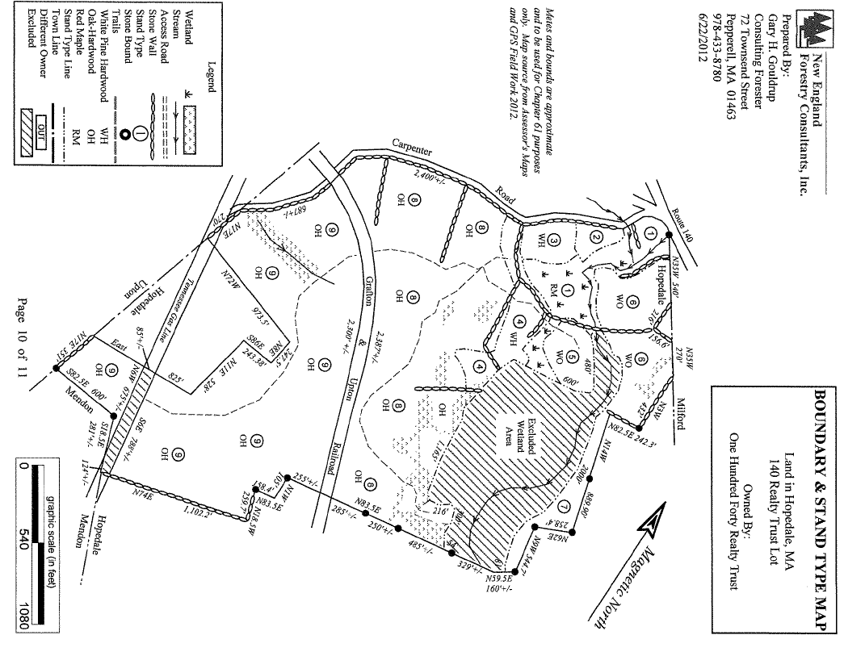

Slide 4
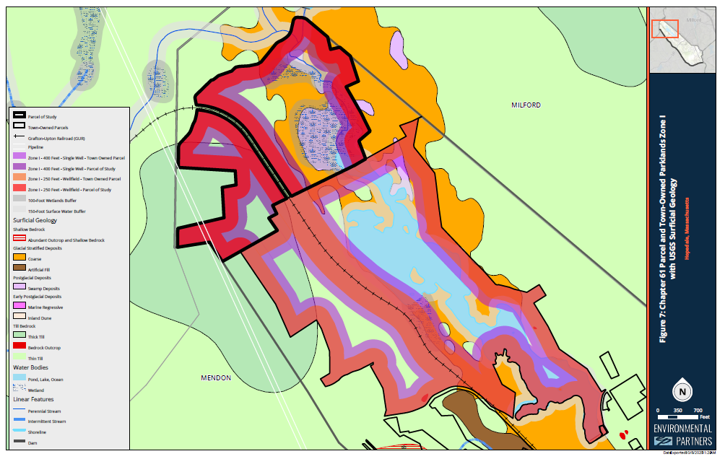

Slide 5
TIMELINE
July 9 | Notice of Intent from Michael R. Mianoski, on behalf of Seller, Charles Morneau, as Trustee for the One Hundred Forty Realty Trust
July 13 | BOS meeting
Aug. 19 | Letter from Peter Durning to counsel for One Hundred Forty Realty Trust and Grafton Upton Railroad
Aug. 28 | Response from counsel for GURR and 140RT acknowledging that Hopedale is not insisting on a new Notice of Intent, just a supplement to clarify the purchase price for the Chap. 61 land
Oct. 7 | Letter from counsel for 140RT purporting to withdraw Notice of Intent
Oct. 8 | Letter from Peter Durning to counsel for 140RT rejected attempted withdrawal of Notice of Intent
Oct. 14 | Recording of certain deeds [notice provided on Oct. 15]
Oct. 14 | Letter from GURR to BOS [received on Oct. 15]
Oct. 20 | Board of Selectmen meeting [no vote will be taken]
Oct. 24 | Special Town Meeting
Nov. 7 | Expiration of 120-day period from delivery of Notice of Intent

Slide 6
Deeds recorded on October 14:
Book Page | Legal Significance
Bk 63493 Pg 31 | Trustee Certificate
Bk 63493 Pg 34 | Deed conveying 363 West Adj and portions of 364 West not subject to G.L. c. 61 to GURR
Bk 63493 Pg 39 | Assignment of Beneficial Interest in Chap. 61 portions of 346 West street to GURR
Bk 63493 Pg 43 | Resignation Trustee Charles E. Morneau
Bk 63493 Pg 45 | Resignation Trustee Gregg Nagel
Notice provided to Hopedale on October 15

Slide 7
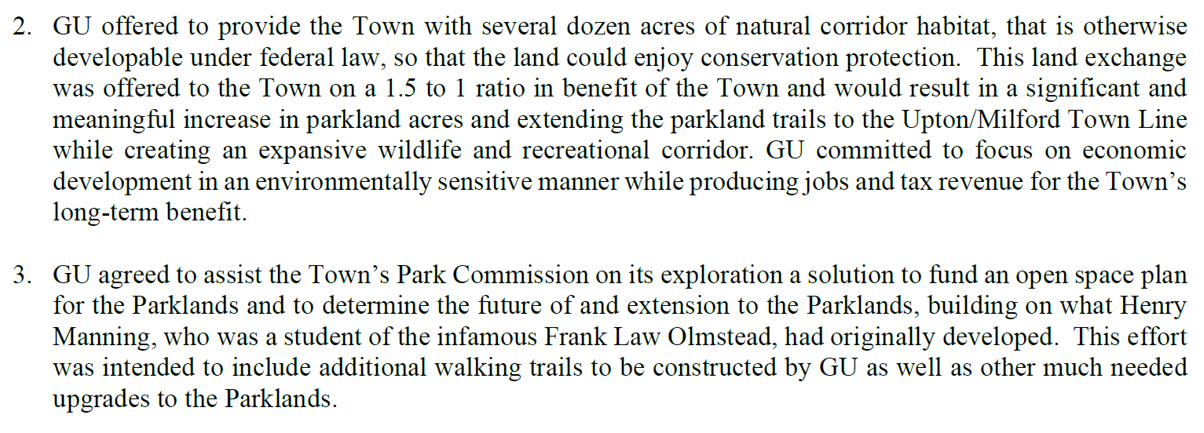
October 15 letter from GURR:

